Slide 1
Unit 4
ISOMETRIC PROJECTIONS

Slide 2
ISOMETRIC PROJECTIONS

Slide 3
ISOMETRIC PROJECTION
It is a method of producing pictorial view of an object showing all three faces of the object simultaneously.
It is a type of parallel projection
It is a type of axonometric projection
In an isometric projection, all angles between the axonometric axes are equal.
To produce an isometric projection, you orient the object so that its principal edges (or axes) make equal angles with the plane of projection and are therefore foreshortened equally.
Isometric drawings are commonly used in technical drawing to show an item in 3D on a 2D page. Isometric drawings, sometimes called isometric projections, are a good way of showing measurements and how components fit together.
ISOMETRIC = EQUAL MEASURE

Slide 4
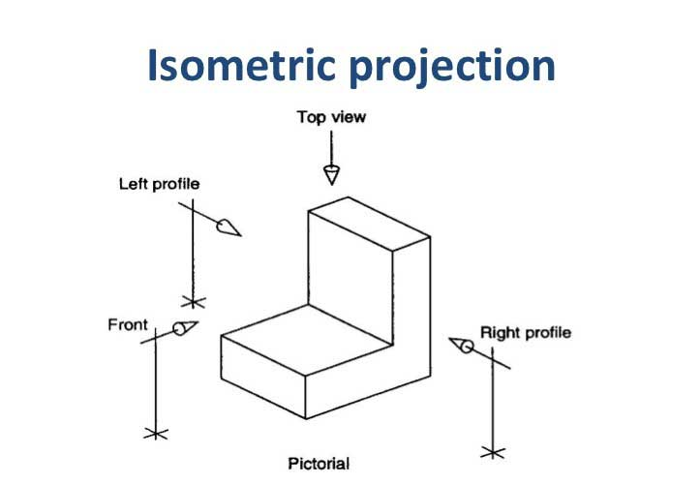
ISOMETRIC PROJECTION

Slide 5
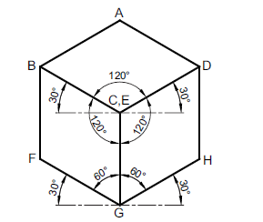
ISOMETRIC PROJECTION
TERMINOLOGY
Referring to Fig., the important terms used in isometric projections are as follows:
1. Isometric axes The three lines CB, CD and CG, meeting at point C and inclined at an angle of 120° with each other, are called isometric axes.
2. Isometric lines The lines parallel to the isometric axes are called isometric lines. Here lines AB, BF, FG, GH, DH and AD are isometric lines.
3. Non-isometric lines The lines which are not parallel to isometric axes are known as non-isometric lines. Here diagonals BD, AC, CF, BG, etc., are non-isometric lines.
4. Isometric plane The plane representing any face of the cube as well as other plane parallel to it is called an isometric plane. Here, ABCD, BCGF, CGHD, etc., are isometric planes.

Slide 6
ISOMETRIC PROJECTION
5. Non-isometric plane The plane which is not parallel to isometric planes are known as non-isometric planes. Here, the plane ABGH, CDEF, AFH, CFH, etc., are non-isometric planes.
6. Isometric scale It is the scale which is used to convert the true length into isometric length. Mathematically, Isometric length = 0.816 X True length
CHARACTERISTICS OF PRINCIPAL LINES IN ISOMETRIC PROJECTION
The following are the characteristics of the principal lines in an isometric projection:
1. All lines that are parallel on the object are parallel on the isometric projection.
2. Vertical line on the object remains vertical in the isometric projection.
3. The horizontal lines on the object are drawn at an angle of 30° with the horizontal.
4. The lines parallel to the principal lines known as isometric lines are equally foreshortened.
5. The lines which are not parallel to principal lines known as non-isometric lines are not equally foreshortened.
For example, diagonals BD and AC are of equal lengths in front view but are of different
lengths in the isometric projection. The non-isometric lines are drawn by locating positions of their ends on isometric planes.

Slide 7
ISOMETRIC PROJECTION
ISOMETRIC PROJECTION AND ISOMETRIC VIEW
In an isometric projection, a scale factor of 0.816 is used to prepare the drawing whereas in an isometric view the true length is used. Thus, the isometric view of an object is larger than the isometric projection.
Because of ease of construction and advantage of measuring the dimensions directly from the drawing, it has become a general practice to use the true lengths instead of isometric lengths.
Figure (a) shows the orthographic views of a cuboid. Figure (b) shows its isometric projection whereas Fig. (c) shows its isometric view.
Thus, isometric projection looks smaller in size than the isometric view. It may be noted that, if it is desired to draw isometric view an object containing some spherical feature it is general practice to draw the isometric projection only.

Slide 8
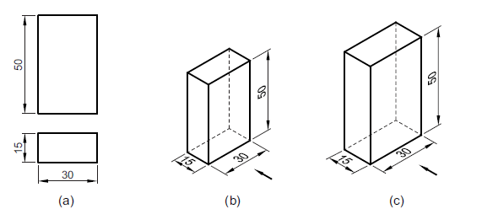
ISOMETRIC PROJECTION
DIMENSIONING ON ISOMETRIC PROJECTION
Following points should be remembered while dimensioning an isometric projection or view:
1. While dimensioning isometric projection or isometric view, the true length should be written for the dimension values.
2. As far as possible all extension lines and dimension lines must be isometric lines, lying in isometric planes.
3. It is usual practice to avoid the hidden lines unless they are essential to make the drawing clear.
4. Centre lines of the circular features should be drawn parallel to the isometric axis.
5. Dimensions for the circular feature should lie on the plane in which it appears to a greater extent.

Slide 9
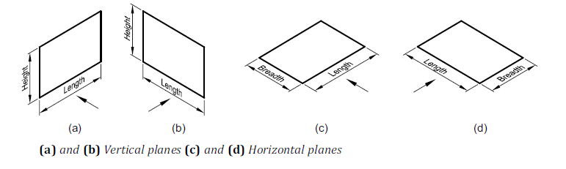
ISOMETRIC PROJECTION
ISOMETRIC VIEW OF PLANES
To draw the isometric view of a plane surface of a lamina, draw a suitable principal plane on which it lies.
Figures (a) and (b) show the vertical principal planes whereas Fig. (c) and (d) show the horizontal principal planes.
The arrow shows the direction for viewing the front view.

Slide 10
ISOMETRIC PROJECTION
When the plane is having its surface parallel to the V.P., then the vertical isometric plane is used to draw the isometric view or projection as shown in Fig. (a) and (b). Height is taken on the vertical axis and the length is taken on the axis inclined at 30° to the horizontal. [Front View]
When the plane is having its surface parallel to the H.P., then horizontal isometric plane is used to draw the isometric view or projection as shown in Fig. (c) and (d). Length and breadth are taken on the different axes each inclined at 30° to the horizontal.
[Top View]

Slide 11
ISOMETRIC PROJECTION
Procedure in AUTOCAD
Turn on “Isodraft” option in Status bar.
Turn on “F3” (Orthographic)
Use “F5” for required direction (Iso Front, Iso Top, Iso Right)
To create circle in isometric “Select Ellipse option – Axis, End – Isocircle”

Slide 12
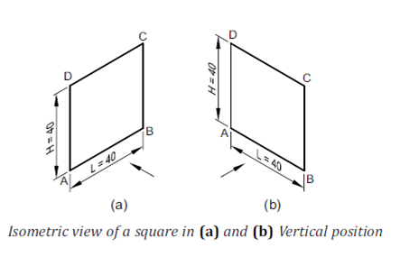
ISOMETRIC PROJECTION
Draw the isometric view of a square of side 40 mm kept in (a) vertical position and
(b) horizontal position.
Construction
When the square is kept vertical (Fig. (a) and (b)).
(a) Draw a 40 mm long vertical line AD.
(b) Draw another 40 mm long line AB inclined at 30° to the horizontal.
(c) Complete the rhombus ABCD which is the required isometric view.

Slide 13
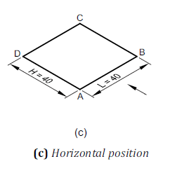
ISOMETRIC PROJECTION
2. When the square is kept horizontal (Fig. (c))
(a) Draw 40 mm long lines AD and AB, each inclined at 30° to the horizontal such that the included angle between them is 120°.
(b) Join ABCD to represent the isometric view of the square.

Slide 14
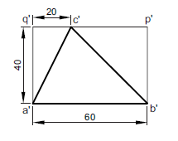
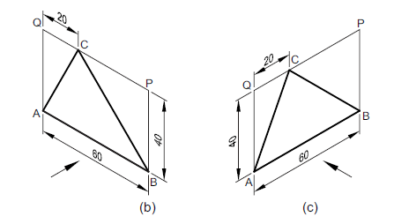
ISOMETRIC PROJECTION
2. Draw the isometric view of a triangle ABC whose front view is shown in Fig.
Sol:

Slide 15
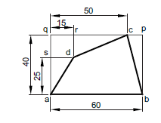
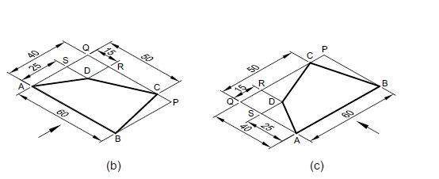
ISOMETRIC PROJECTION
3. Draw the isometric view of a quadrilateral ABCD whose top view is shown in Fig.
Sol:

Slide 16
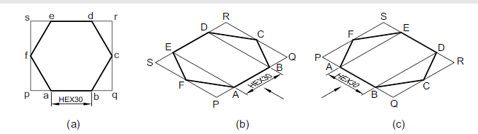
ISOMETRIC PROJECTION
4. Draw the isometric view of a hexagon of side 30 mm whose surface is parallel to the
H.P. and a side parallel to the V.P.
Sol:

Slide 17
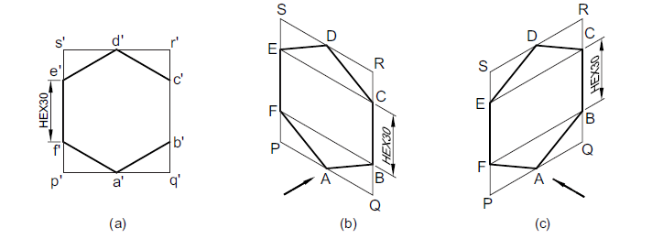
ISOMETRIC PROJECTION
5. Draw the isometric view of a hexagonal plane of side 40 mm whose surface is parallel
to the V.P. and a side perpendicular to the H.P.
Sol:

Slide 18
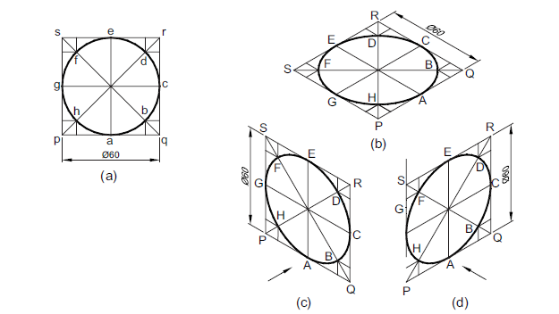
ISOMETRIC PROJECTION
6. Draw the isometric view of a circle of diameter 60 mm on all the three principal
planes using coordinate method.
Sol:

Slide 19
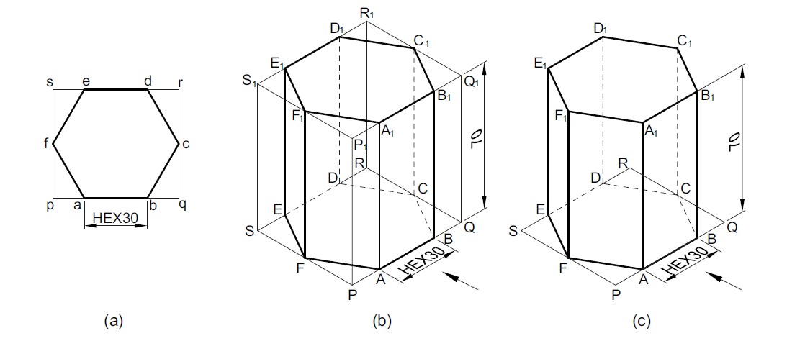
ISOMETRIC VIEW OF SOLID CONTAINING NON-ISOMETRIC LINES
1. Draw the isometric view of a square prism of base side 40 mm and axis 60 mm
resting on the H.P. on the (a) base with axis perpendicular to the H.P., (b) rectangular face with axis perpendicular to the V.P., and (c) rectangular face with axis parallel to the V.P.
Sol:

Slide 20
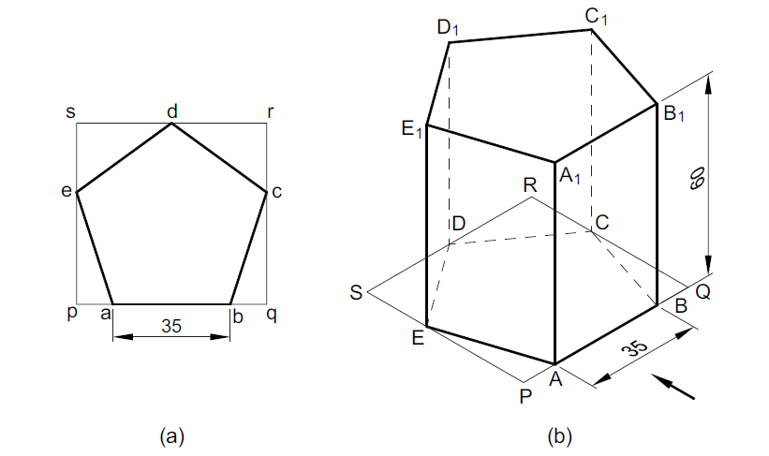


ISOMETRIC VIEW OF SOLID CONTAINING NON-ISOMETRIC LINES
2. Draw an isometric projection of a pentagonal prism of base side 35 mm and axis
60 mm. The prism rests on its base on the H.P. with an edge of the base parallel to the V.P.
Sol:

Slide 21
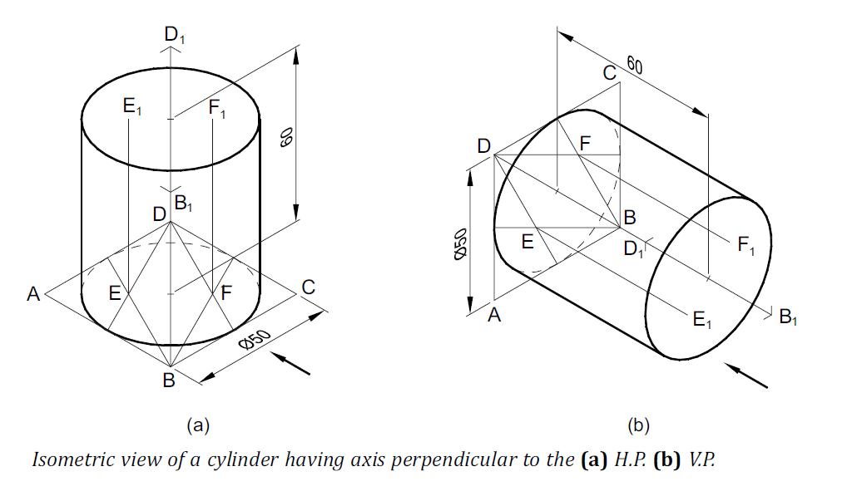
ISOMETRIC VIEW OF SOLID CONTAINING NON-ISOMETRIC LINES
3. Draw the isometric view of a cylinder of base diameter 50 mm and axis 60 mm. The
axis of the cylinder is perpendicular to the (a) H.P., (b) V.P.
Sol:

Slide 22
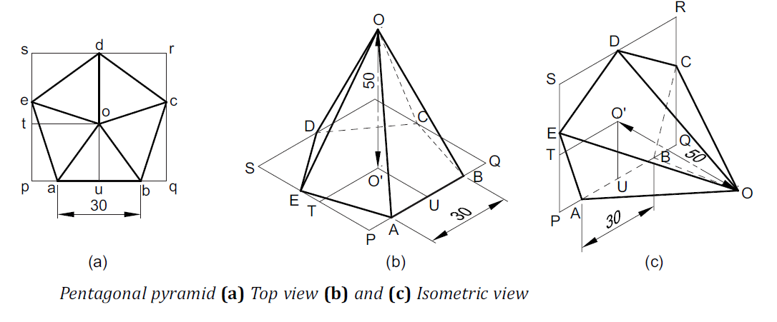
ISOMETRIC VIEW OF SOLID CONTAINING NON-ISOMETRIC LINES
4. Draw the isometric view of a pentagonal pyramid of base side 30 mm and axis 50
mm. The pyramid is kept on its base on the (a) H.P. (b) V.P.
Sol:

Slide 23
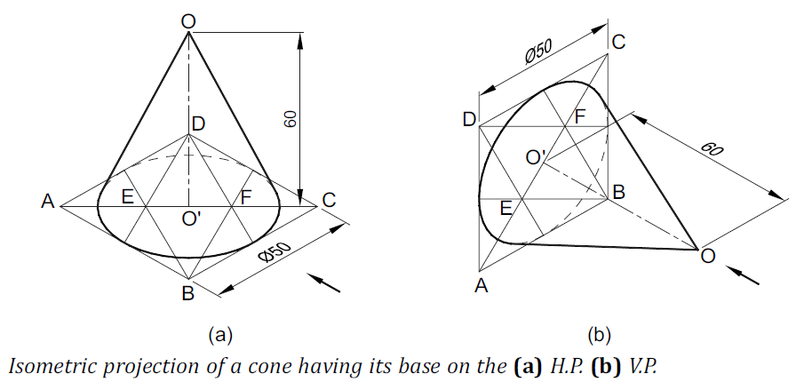
ISOMETRIC VIEW OF SOLID CONTAINING NON-ISOMETRIC LINES
5. Draw the isometric projection of a cone of base diameter 50 mm and axis 60 mm.
The cone has its base on the (a) H.P. (b) V.P.
Sol:

